Slide 1


Sales price for Properties in

Slide 2
Note: My coworker (Karim Gamal) and I decided to solve the same problem, but we each have our own way of cleaning, and we also have different research questions.

Slide 3

Goal
For this project, I'm going to build a machine learning model that could predict the property sales price for properties in NYC. I'm dividing my project into the following sections:
EDA
Data Preparation
Modelling

Slide 4
Exploratory Data Analysis (EDA)
The EDA is divided in the following steps:
Basic data exploration
Identification of variables and data types
Missing values
Univariate Analysis
Bivariate Analysis
Correlation matrix
Conclusion
Note :
The data size before EDA was 26,118 records x 21 features.
And after EDA it was 13,196 records x 19 features.

Slide 5

DATA Preprocessing

Slide 6
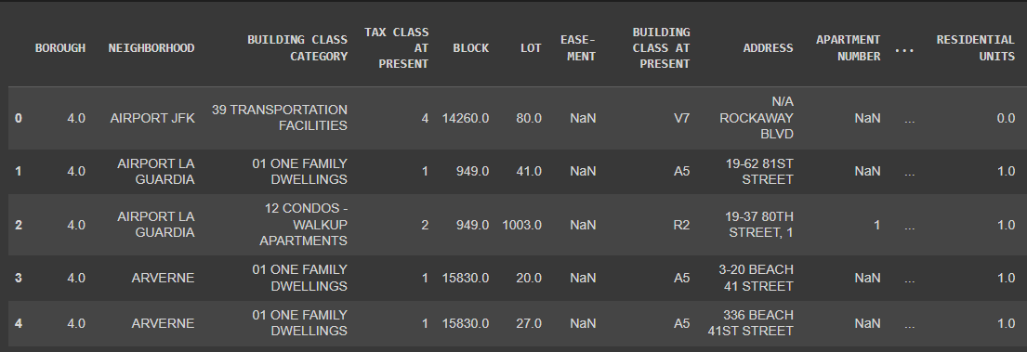
Dataset

Slide 7
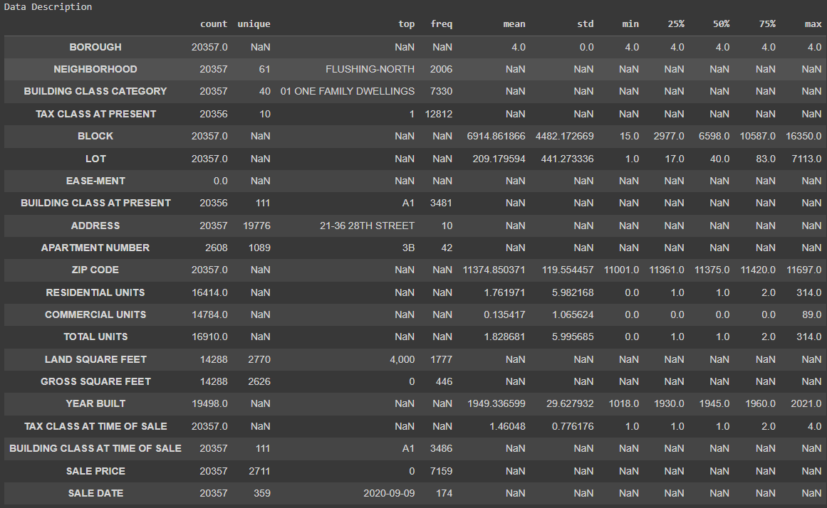

data description

Slide 8
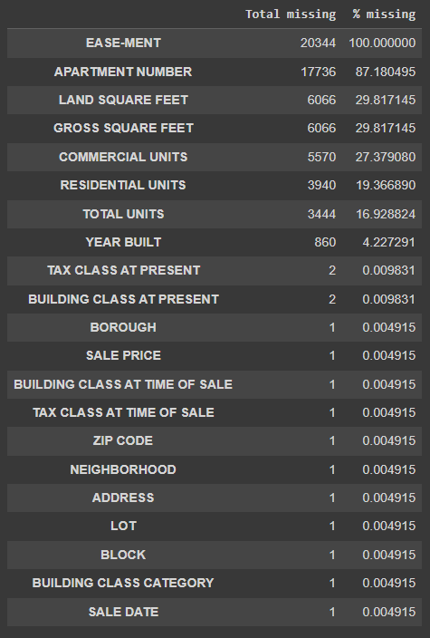

Data Cleaning
Missing Values
Data Duplicate: we have ‘5774’ duplicate records so I will remove all the duplicates
The Shape Of The Data After Remove Duplicates

Slide 9
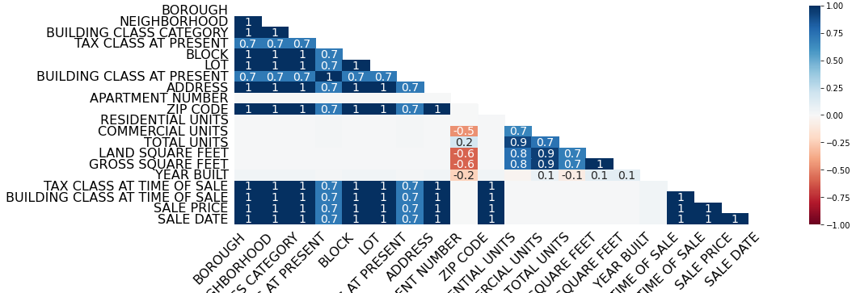
Missing values Correlation

Slide 10
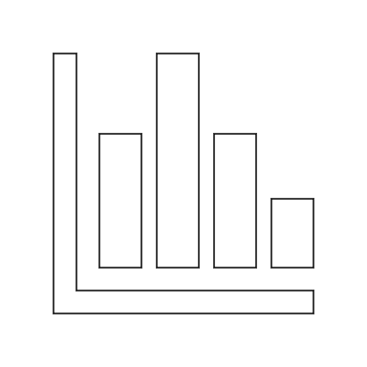
DATA Exploration

Slide 11

EASE-MENT & APARTMENT NUMBER Columns
As we can see, these two columns contains more than 50% missing values.

Slide 12
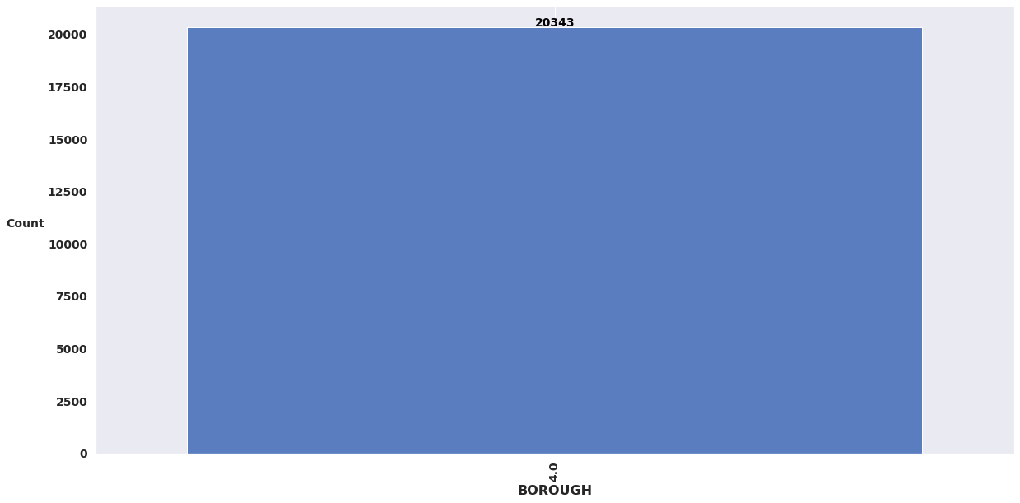
BOROUGH Column
As we can see, this column contains only one value, So we will drop it

Slide 13
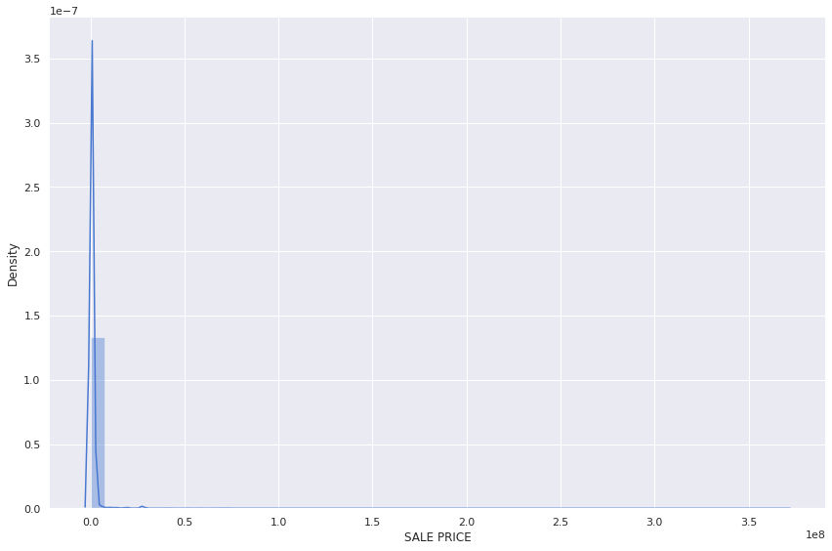
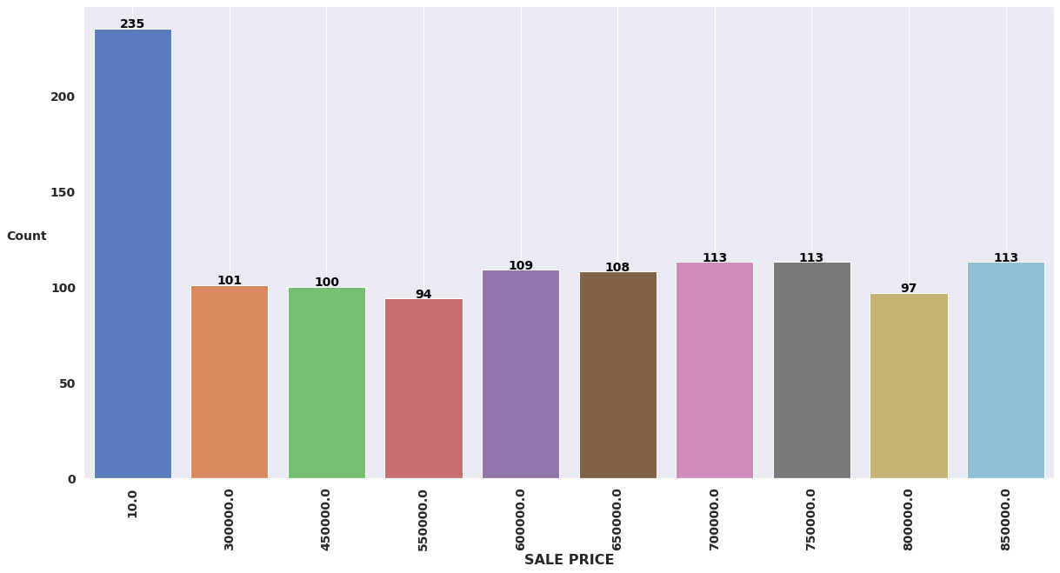
SALE PRICE Column
In this column, I dropped all records which have a ‘0’ value

Slide 14
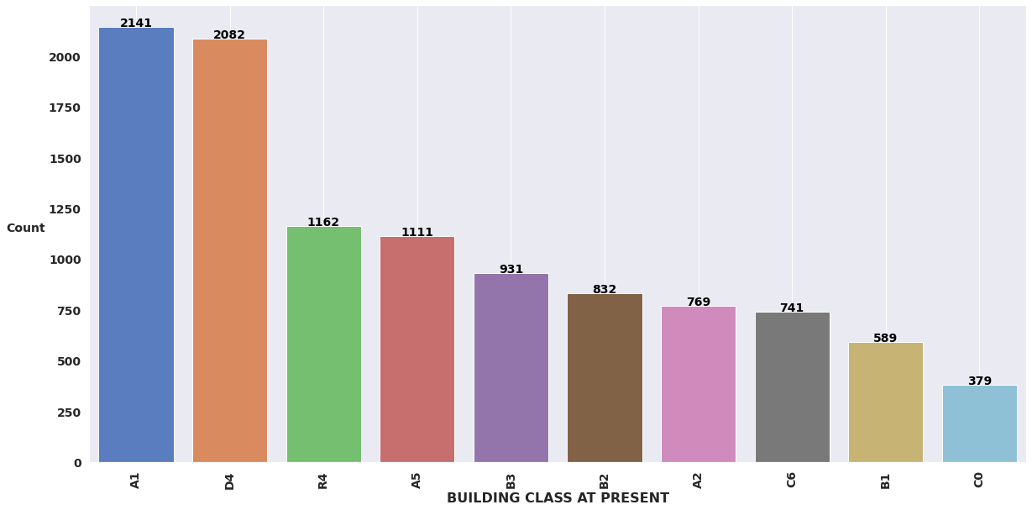
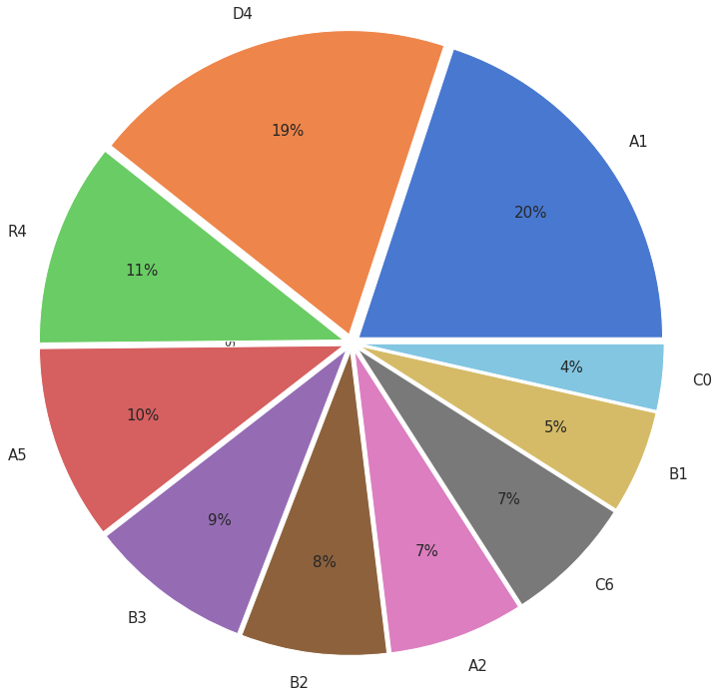
BUILDING CLASS AT PRESENT Column
This column have ’97’ unique values

Slide 15
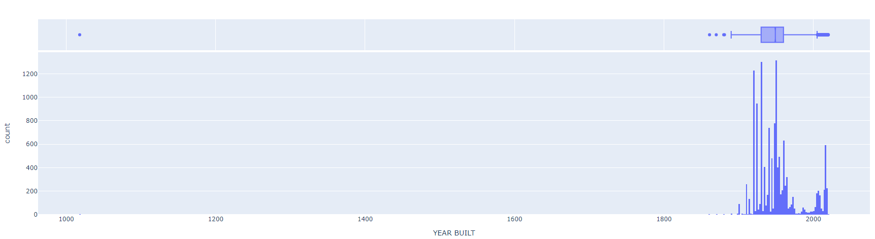
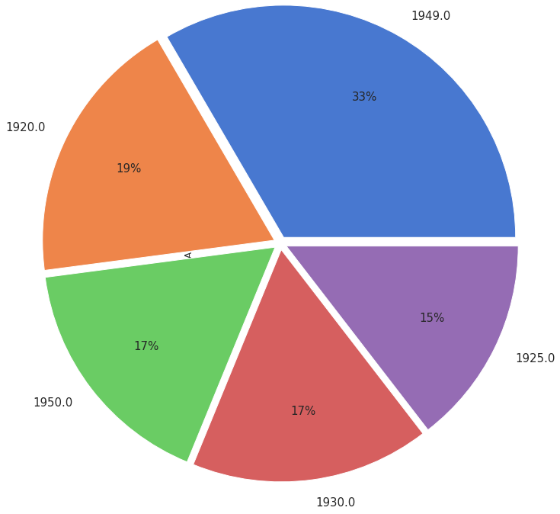
YEAR BUILT Column
This column have ’123’ unique values

Slide 16
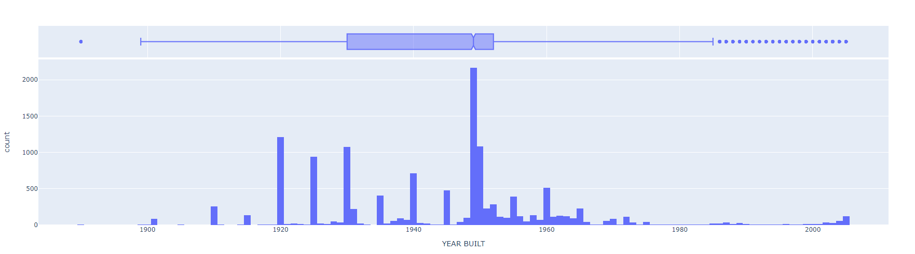
YEAR BUILT Column
After Removing Outliers

Slide 17
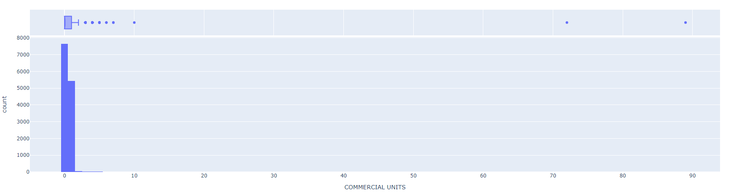
COMMERCIAL UNITS Column
This column have ’11’ unique values

Slide 18
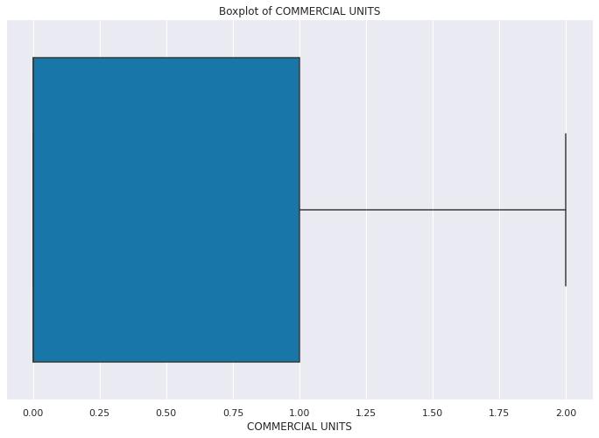
COMMERCIAL UNITS Column
After Removing Outliers

Slide 19
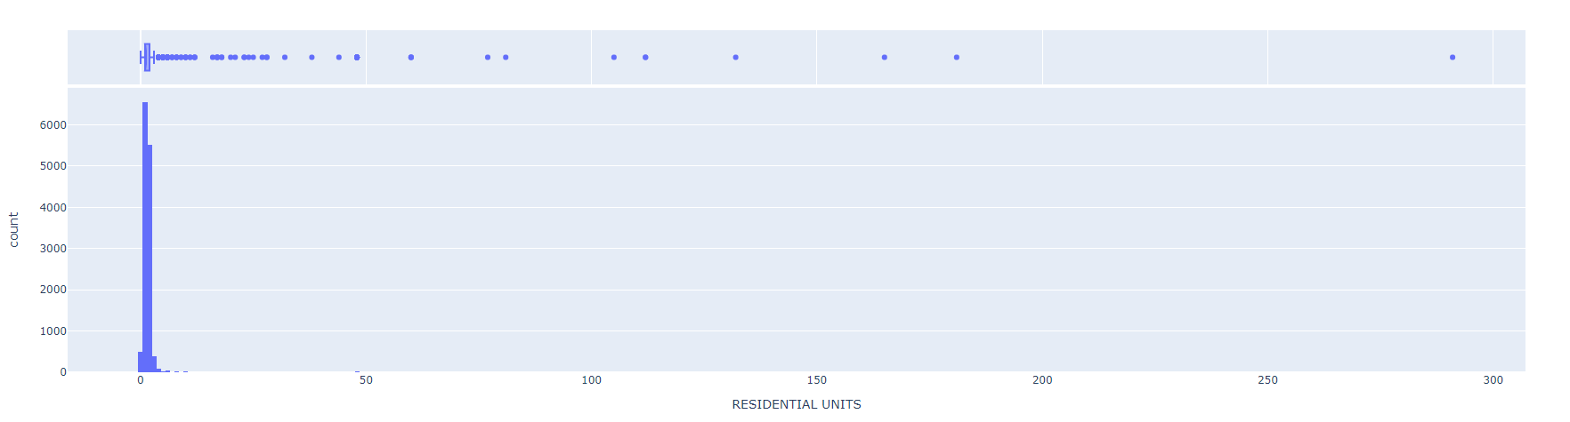
RESIDENTIAL UNITS Column
This column have ’36’ unique values

Slide 20
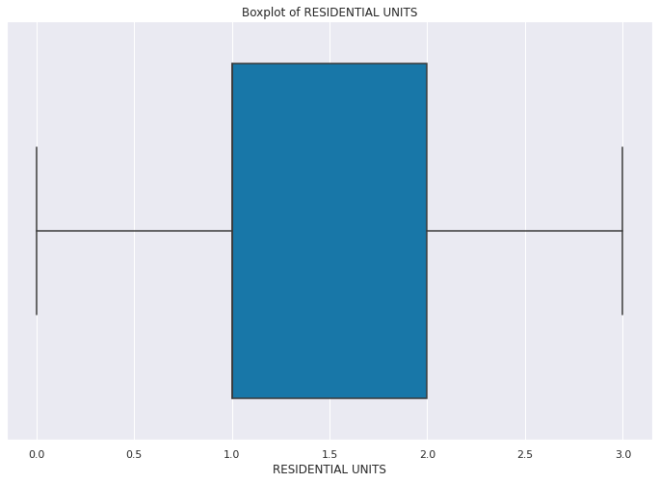
RESIDENTIAL UNITS Column
After Removing Outliers

Slide 21
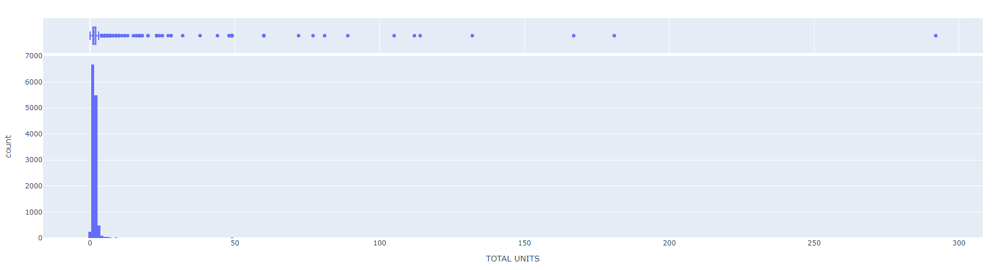
TOTAL UNITS Column
This column have ’41’ unique values

Slide 22
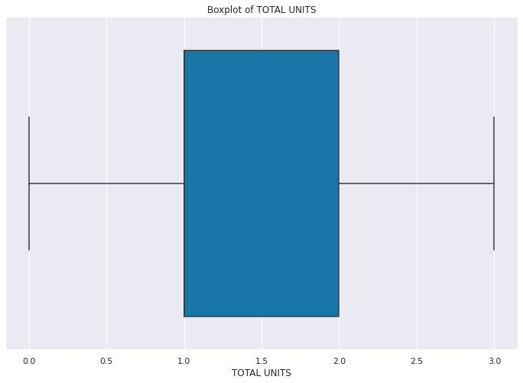
TOTAL UNITS Column
After Removing Outliers

Slide 23
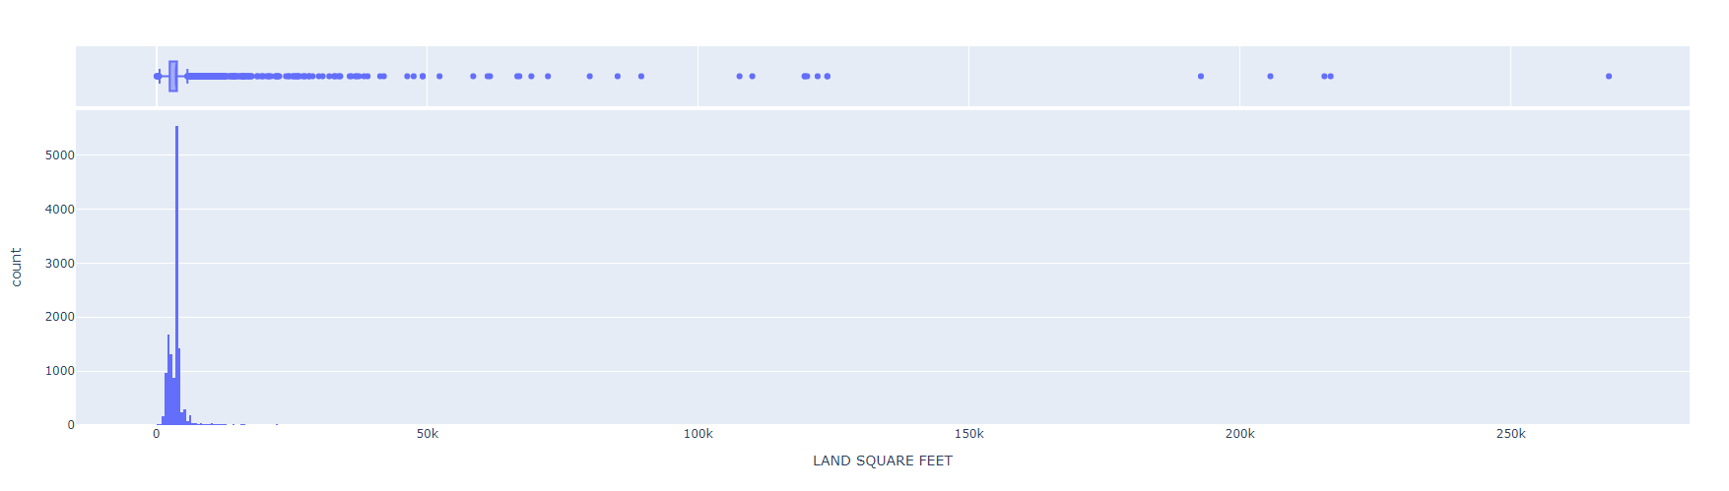
LAND SQUARE FEET Column
This column have ’ 1939’ unique values

Slide 24
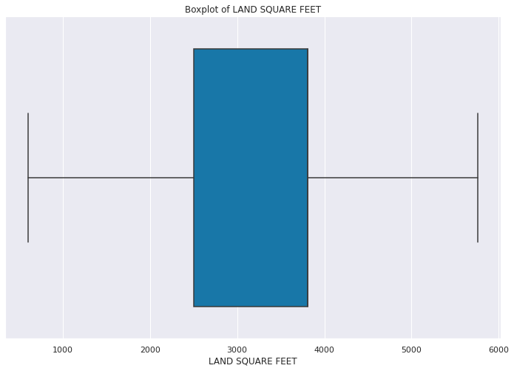
LAND SQUARE FEET Column
After Removing Outliers

Slide 25
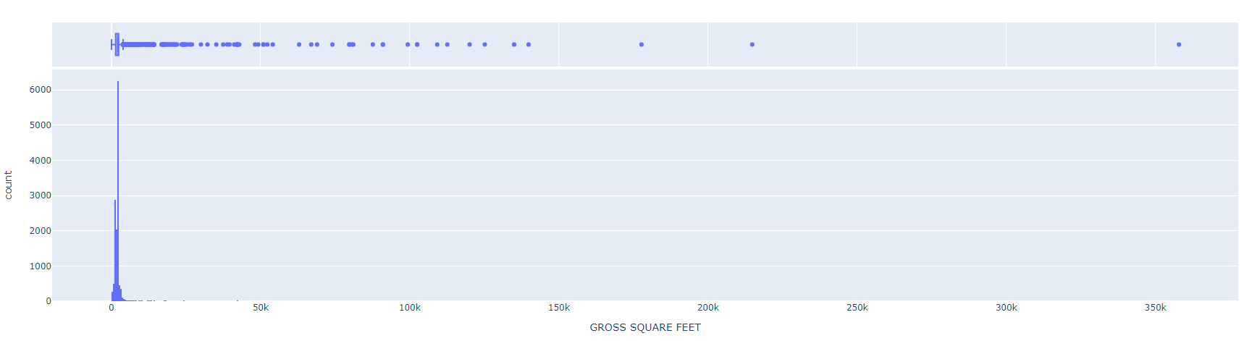
GROSS SQUARE FEET Column
This column have ’ 1995’ unique values

Slide 26
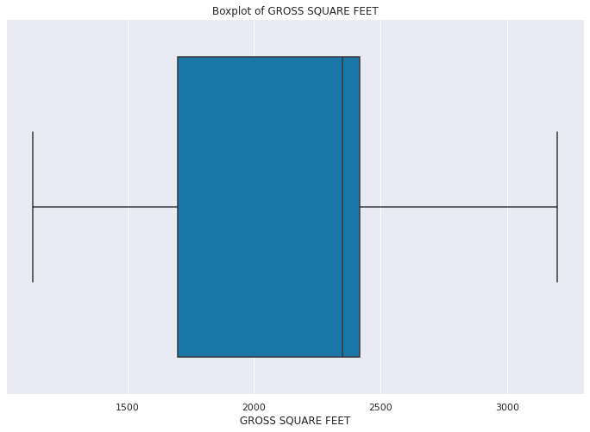
GROSS SQUARE FEET Column
After Removing Outliers

Slide 27
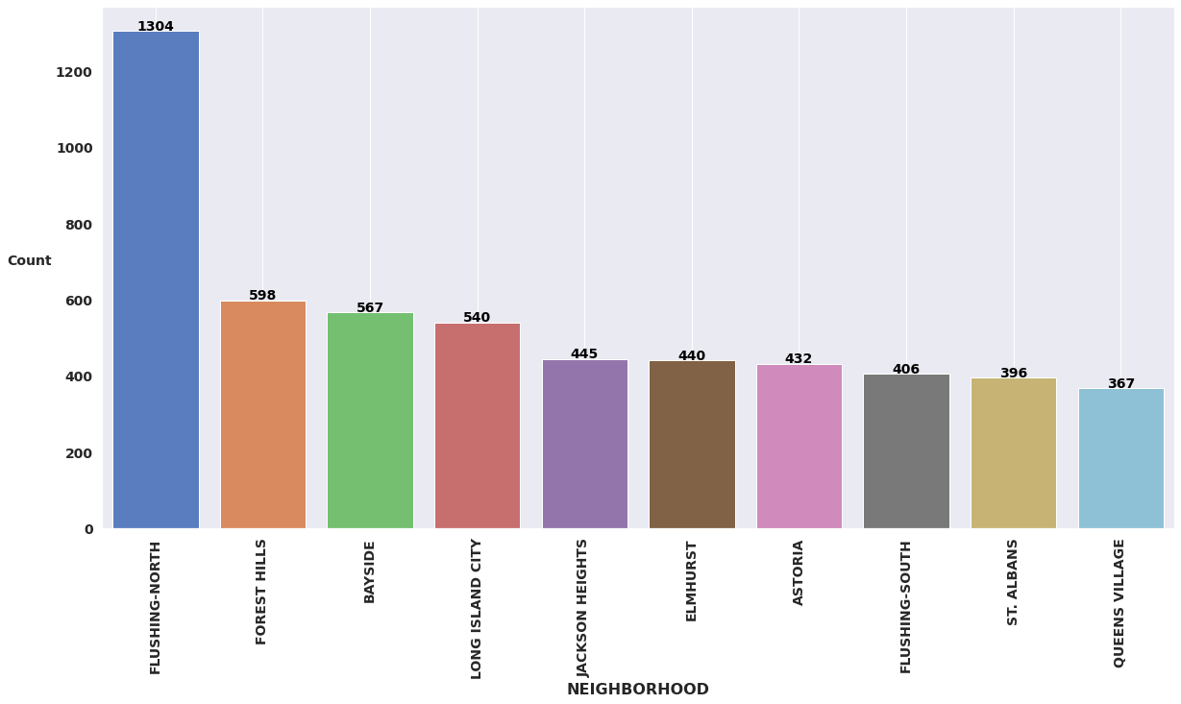
NEIGHBORHOOD Column
This column have ’ 61’ unique values

Slide 28
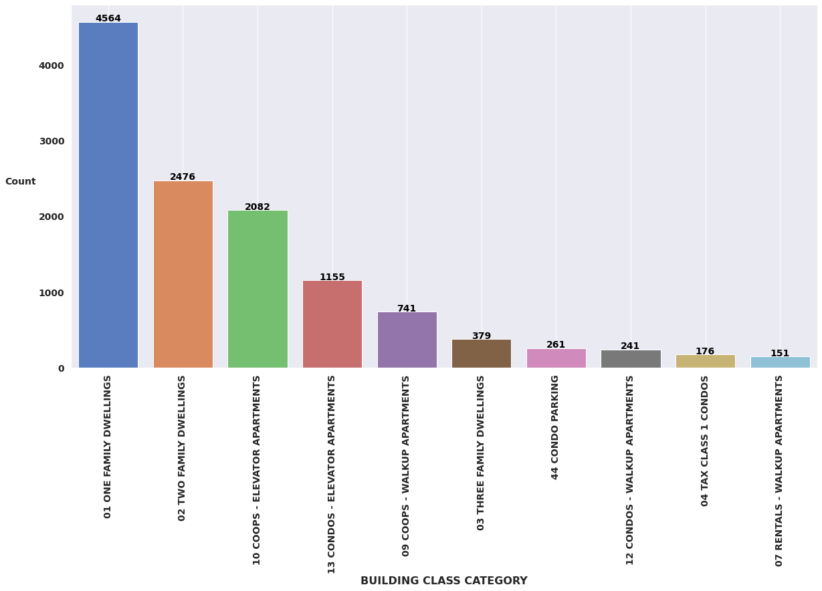
BUILDING CLASS CATEGORY Column
This column have ’ 40’ unique values

Slide 29
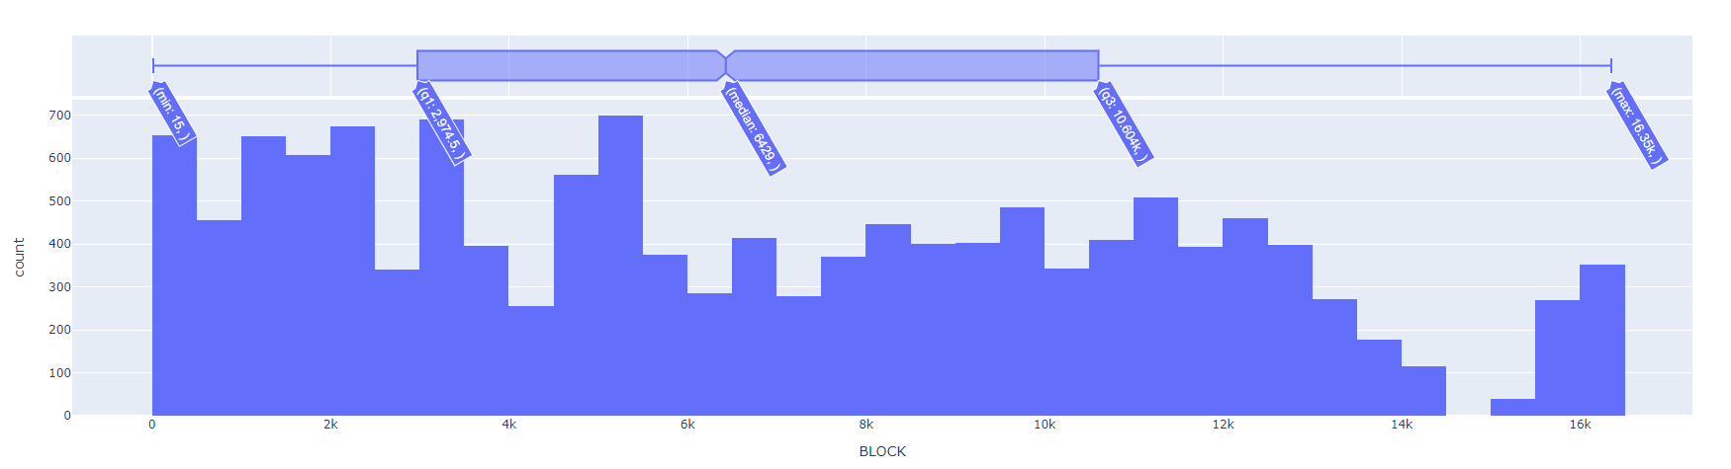
BLOCK Column
This column have ’ 5640’ unique values

Slide 30
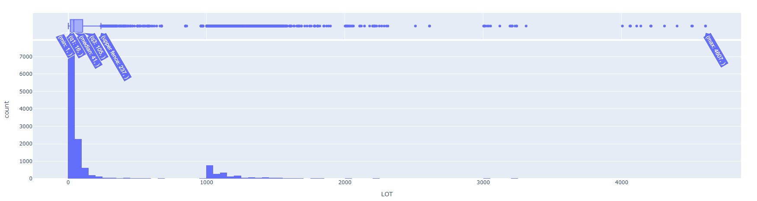
LOT Column
This column have ’936’ unique values

Slide 31
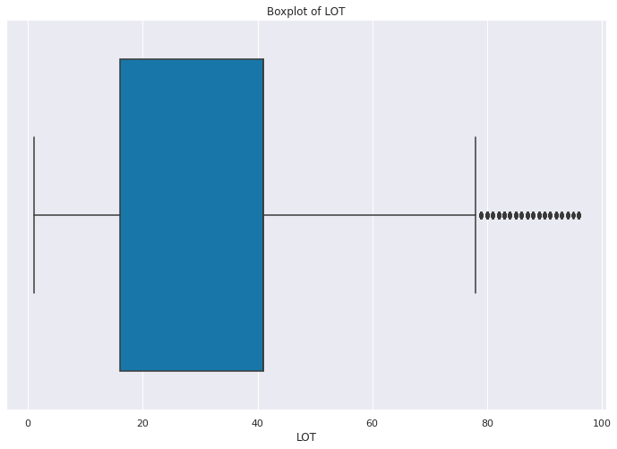
LOT Column
After Removing Outliers

Slide 32
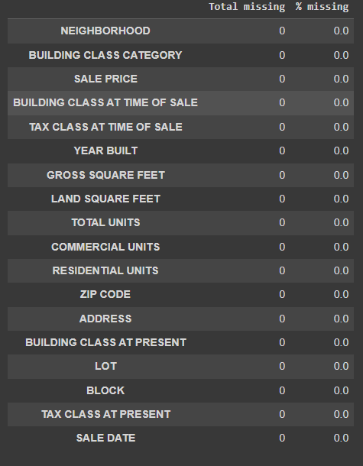


After Data Cleaning
After cleaning the data shape is (13196 X 18) wit zero missing data and zero duplicates
Data Shape And Data duplicate
Missing values

Slide 33
Convert Categorical To numerical

Slide 34
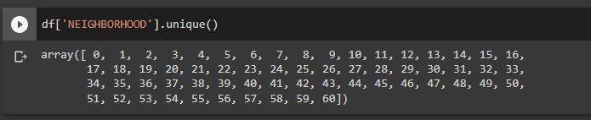
NEIGHBORHOOD Column
We have 61 unique values so I will use Label encoding

Slide 35
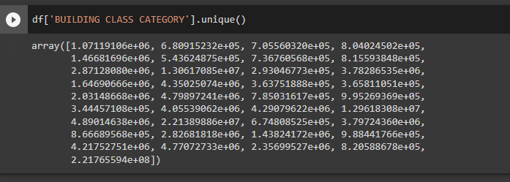
BUILDING CLASS CATEGORY Column
We have 40 unique values so I will use Target encoding

Slide 36
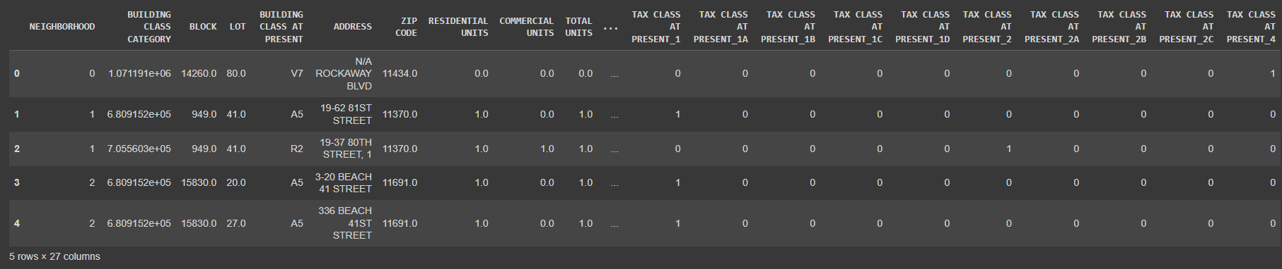
TAX CLASS AT PRESENT Column
We have 10 unique values so I will use one hot encoding

Slide 37
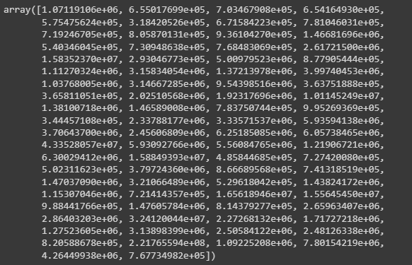
BUILDING CLASS AT PRESENT Column
We have 97 unique values so I will use Target encoding

Slide 38
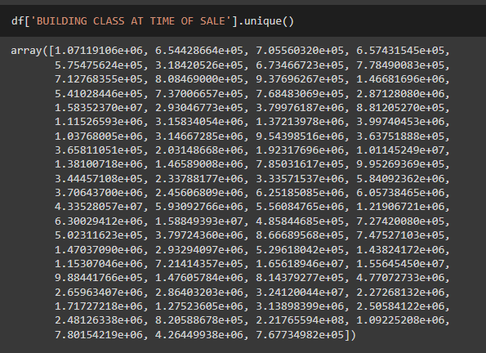
BUILDING CLASS AT TIME OF SALE Column
We have 98 unique values so I will use Target encoding

Slide 39
Feature selection

Slide 40
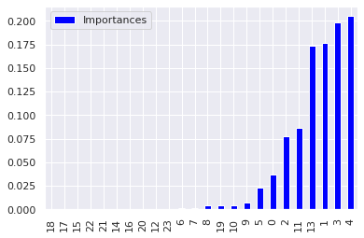
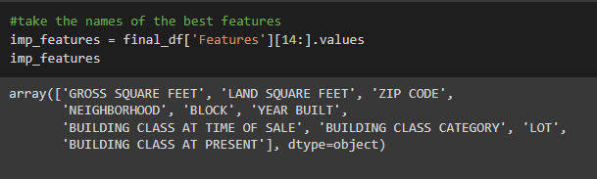
RandomForestRegressor for Selection

Slide 41
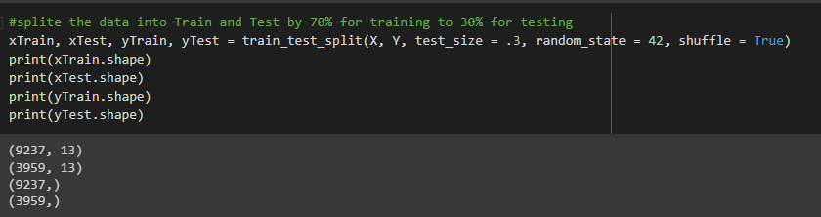
Train , Test Split
We split the data to 70% for tanning and 30% for testing

Slide 42
Predictions and evaluation
Mean Absolute Error (MAE): Every residual (distance between fitted line and observation) needs to be calculated for every data point, taking only the absolute value of each. Then the average of the residuals is the MAE.
Mean Squared Error (MSE): The MSE is just like the MAE, but squares the difference before summing them all instead of using the absolute value. MSE is more popular because it punishes larger which tend to be useful in the real world.
R2: In regression, R2 a statistical measure of how well the regression predictions approximate the real data points.

Slide 43
Models results
Algorithm | MAE | MSE | RMSE | R^2
RandomForestRegressor Model | 0.044 | 0.0225 | 0.4749 | 0.782
Linear Regression Model | 0.1526 | 1.481 | 1.217 | -0.4303
KNN MODEL | 0.0937 | 1.068 | 1.0336 | -0.031
SVR MODEL | 0.1035 | 0.971 | 0.9852 | 0.0638
DecisionTreeRegressor MODEL | 0.1058 | 1.77 | 1.33 | -0.71
GradientBoostingRegressor MODEL | 0.1108 | 1.673 | 1.293 | -0.615
AdaBoostRegressor MODEL | 0.295 | 1.925 | 1.387 | -0.817
XGBRegressor MODEL | 0.095 | 1.632 | 1.277 | -0.576
As we can see, The best two models are Random forest and SVR

Slide 44
Research questions:
what are the number of units are sold for each month?
What is the new building at the lowest selling price?

Slide 45
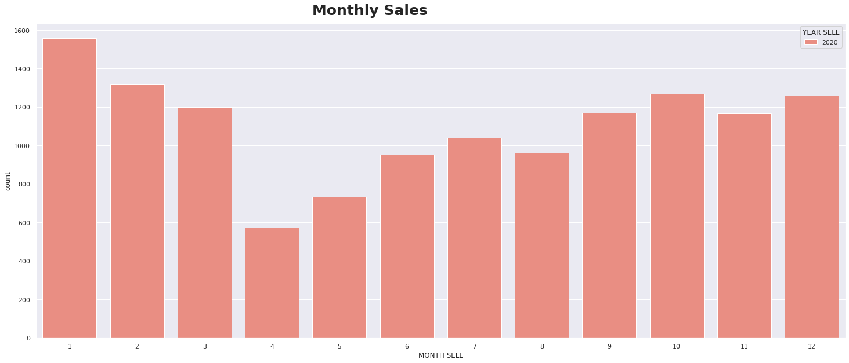
what are the number of units are sold for each month?
So, As we see from the previous results, we can get that:
- The Maximum value is around ‘1600’ Data records ==> [Month: 1]
- The Minimum value is around ‘600’ Data ==> [Month: 4]
This question is important for real estate companies to know the best time of the year to buy buildings to save more money and to know the best time of the year to sell buildings to make a lot of money
And our audience are any company, or any person wants to buy an apartment

Slide 46
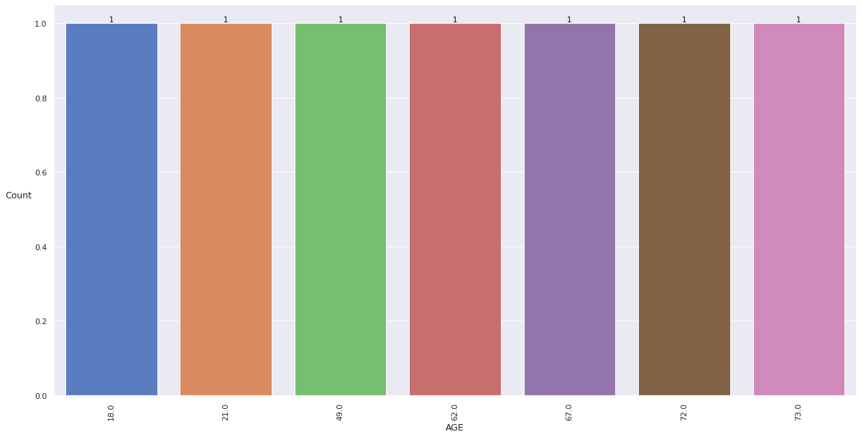
what are the number of units are sold for each month?
Also, We can see that the newest building with the lowest selling price is the one that was built “18” years ago with a selling price of “1”
This question is very important for everyone because all people are looking for new homes with low budget
And our audience is the one who wants to buy a new building or apartment

Slide 47

Thank You

